Slide 1


Questions to Answer
“Does COVID-19 ‘survive the winter’ and have higher prevalence rates in countries with higher latitudes?”
“Does it matter if you consider cumulative incidence rather than cumulative prevalence?”
“Does a person count twice toward cumulative incidence rates if he had COVID-19 more than once?“
“Back to the ‘distance-from-the-equator thing, what proof do you have besides ‘bubble size’?”
“What was the big deal about the first million cases? Or first 100,000 deaths?
What is a milestone?”
“Do countries that do better preventing chronic illness have fewer COVID-19 deaths?”
“Do countries with higher population densities have higher COVID-19 cumulative incidence?”
“Is there a correlation between case counts of SARS/MERS and COVID-19 prevalence rates in countries?”
“Did anyone really think that New York City could produce the number of specially trained RNs to care for the patients who would be using the 40,000 additional ventilators that the governor insisted they require?”
Notes:
Jolene Branch
Data Science Program, Bellevue University
DSC 680: Applied Data Science
June 27, 2021

Slide 2
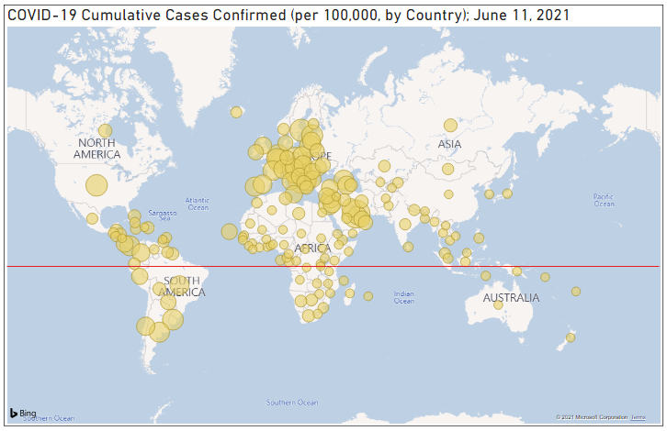
“Does COVID-19 ‘survive the winter’ and have higher prevalence rates in countries with higher latitudes?”
It looks like the circles tend to be larger the further they are from the equator, right?
Note: Larger circle size indicates higher cumulative incidence

Slide 3
“Does it matter if you consider cumulative incidence rather than cumulative prevalence?”
Not so much for a brand-new disease, especially if you are considering cumulative case counts from the beginning until now.

Slide 4
“So then does a person count twice toward cumulative incidence rates if he had COVID-19 more than once?”
Maybe.
Only if tested more than once.
Scare reports of this occurring.
Notes:
point prevalence vs. period prevalence, https://www.cdc.gov/csels/dsepd/ss1978/lesson3/section2.html
The dataset used did not use point prevalence or period prevalence. It used cumulative cases, and the description table did not specify if this referred to unique persons or not. Therefore, it is likely that the cumulative cases reported in this dataset will include individuals who tested positive, then negative at least twice at a minimum number of days between testing (or whatever standard each country uses), then positive again. Reports of this occurring have been scarce, and likely do not affect conclusions gained from this project.

Slide 5
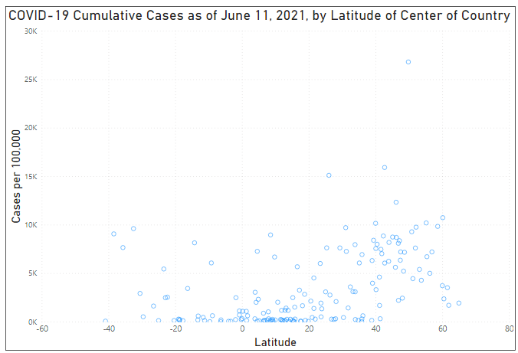
“Back to the ‘distance-from-the-equator thing, what proof do you have besides ‘bubble size’?”
What letter do these data points take the form of? What does that mean?
Notes:
Since distance from the equator can be calculated as the absolute value of the latitude, a latitude of 40 is the same distance from the equator as a latitude of -40. From this chart a sort of ‘V’ shape among rates of COVID-19 prevalence as compared to latitude of the center of the country. This suggests a correlation between latitude and COVID-19 prevalence.

Slide 6
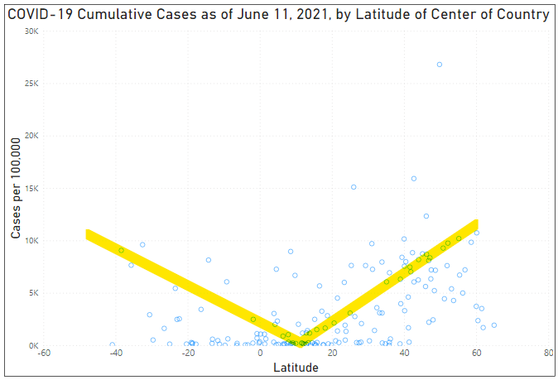
Notes:
Since distance from the equator can be calculated as the absolute value of the latitude, a latitude of 40 is the same distance from the equator as a latitude of -40. From this chart a sort of ‘V’ shape among rates of COVID-19 prevalence as compared to latitude of the center of the country. This suggests a correlation between latitude and COVID-19 prevalence.

Slide 7
“What was the big deal about the ‘first million cases’ or ‘first 100,000 deaths?’ What is a ‘milestone?’
‘Round numbers’
Sound scary and get peoples’ attention
No statistical significance
Potential for misunderstanding is great
Notes:
Use of arbitrary numbers ending with a lot of zeros has great potential to skew peoples’ understanding of the severity of the disease and/or its spread.
When the news announcer says “The U.S. has hit a milestone 1 million cases today,” the viewer has no context for that statement and is likelier than not to interpret that somehow things are worse today than they were yesterday.
The only thing ‘milestone’ about 1 million cases is that there are 1 million more than when we had zero cases.
Better uses of the term milestone might be the date that vaccinations started or the number of days since disease discovery until vaccine approval or the point at which the number of deaths exceeds the number of deaths of some other significant event in history.
Without any context, there really is no milestone.

Slide 8
“Do countries that do better preventing chronic illness have fewer COVID-19 deaths?”
Counts vs rates
Apples to oranges!

Slide 9

“So we can’t tell if countries that do better preventing chronic illness have fewer COVID-19 deaths?”
Notes:
With just a couple lines of code, using the right library, the dataset that was already cleaned and ‘wrangled’ in R can produce some amazing insights.

Slide 10
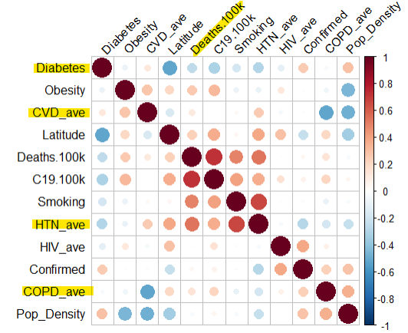
“So we can’t tell if countries that do better preventing chronic illness have fewer COVID-19 deaths?”
Yes, we can! COVID-19 death rates are higher in countries that do poorer at prevention of chronic medical conditions. *Diabetes appears to be reversed.
Perfect positive correlation
Perfect negative correlation
Notes:
The key to comparing different variables and attempting any kind of regression or correlation is to convert case counts to case rates, based on population.
In the correlation matrix, COVID deaths have a positive correlation with every chronic condition listed EXCEPT DIABETES. The only variable on the correlation matrix that does not have a positive correlation with death, interestingly, is diabetes. Not even in the media has it been suggested that having diabetes is some sort of protective factor against COVID-19! Since diabetes and obesity do not show as having a positive correlation (which is simply common knowledge), this is a clue that something is amiss with the diabetes variable within this dataset.

Slide 11
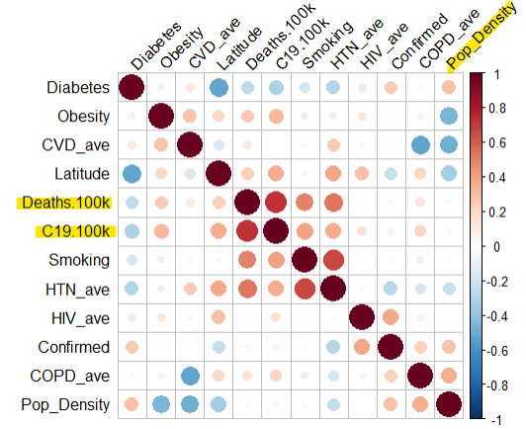
“Do countries with higher population densities have higher COVID-19 cumulative incidence?”
There does not appear to be a correlation between population density and COVID-19 cases per 100,000 or COVID-19 deaths per 100,000.
Notes:
This seems surprising.

Slide 12
“Is there a correlation between case counts of SARS/MERS and COVID-19 prevalence rates in countries?”
Sure. If you want there to be.
Or not, if you don’t want it!
super small case count = easy to ‘spin’ the data
Notes:
Upon further review of SARS and MERS data as collected by the Johns Hopkins Whiting School of Engineering, it was discovered that so few countries had formally reported actual cases of SARS and MERS, that valid comparison with COVID-19 case prevalence would not be possible. There simply is not enough case count data.

Slide 13
“Did anyone really think that New York City could produce the number of specially trained RNs to care for the patients who would be using the 40,000 additional ventilators that the governor insisted they require?”
Certainly not anyone in healthcare.
At a superhero-like 1:2 staffing ratio, with every ICU RN working 12-hour shifts, 7 days a week, with no absences due to illness or quarantine, you would need 40,000 additional ICU RNs.
“A source of unbiased reporting of COVID-19 information (and a lot of other things) is not known. However, unbiased data is available.”
Notes:
Care of ventilator-dependent intensive care unit (ICU) patients is generally done at a 1:1 or 1:2 staffing ratio.
Add in the immense amount of time to ‘suit up’ for each trip into a patient room, and a 1:2 ratio would quickly wear down even the most experienced, energetic RN.
Assuming that everything else is perfect, and that these superheroes could work 12 hour shifts, 7 days per week indefinitely, you would need an additional 40,000 experienced ICU RNs to staff the patients on the requested 40,000 additional ventilators. And that doesn’t even take the doctors into account!
Yes, of course you can shift staff around, especially as in-person clinic visits and elective surgeries are cancelled, but none of those actions will produce 40,000 ICU RNs.

